Slide 1
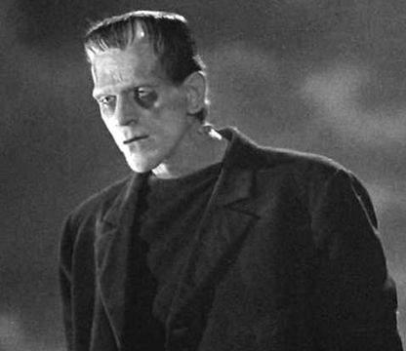
Frankenstein
Volume Three

Slide 2
Quiz
1. What does the creature decide to do in the final paragraph of the entire novel?
2. Will Captain Walton continue on his journey to the North Pole? Yes or No
3. Which member of Frankenstein’s family survives?
4. Who says, “Wretch! It is well that you have come here to whine over the desolation that you have made…It is not pity that you feel ; you lament only because the victim of you malignity is withdrawn from your power.”
Extra Credit: Name three locations where Frankenstein travels and/or lives

Slide 3
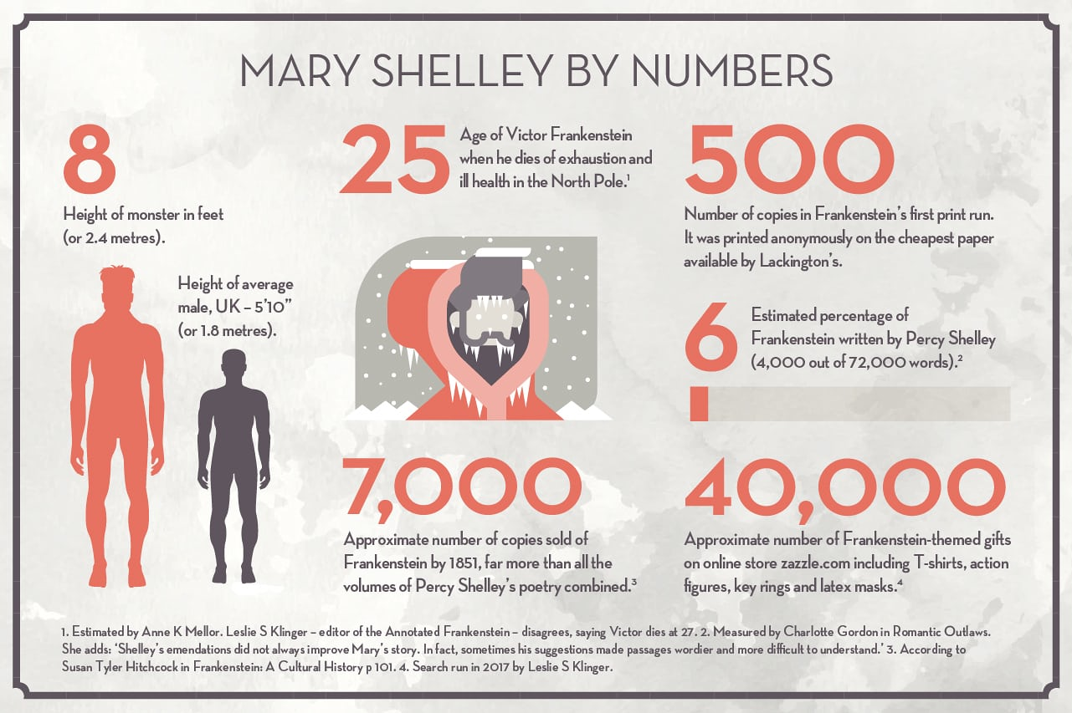
Statistics

Slide 4
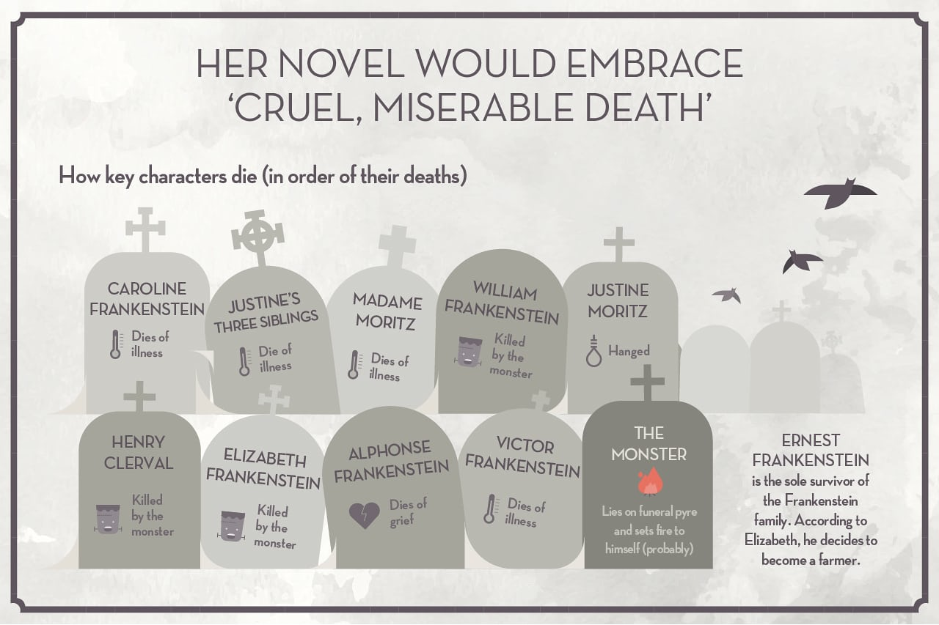
Stats

Slide 5
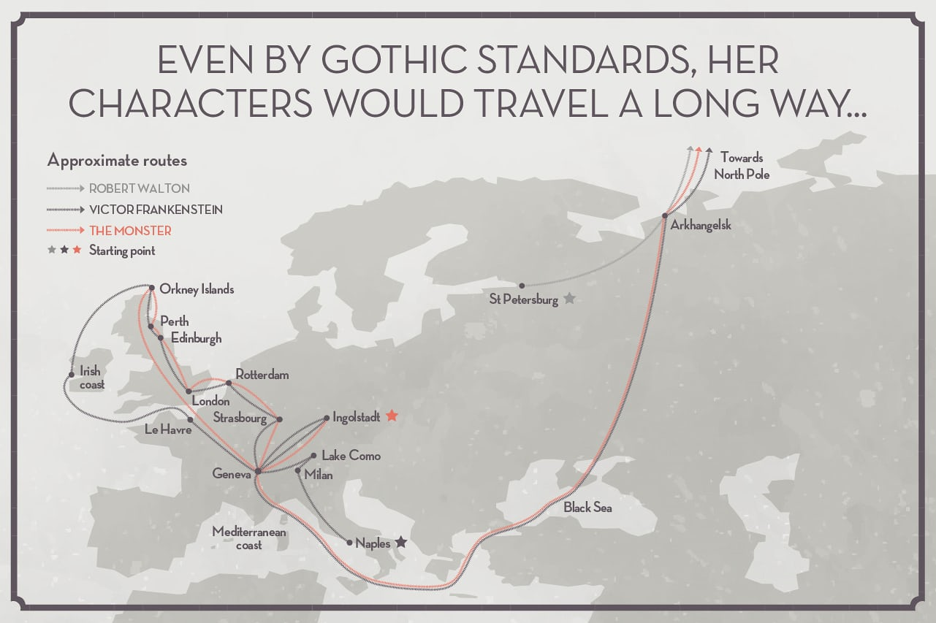
Mapping their Travels

Slide 6
Terms To Know
Bildungsroman
Archetype
Gothic fiction
Narcissism

Slide 7
Bildungsroman
This is typically a type of novel that depicts an individual’s coming-of-age through self-discovery and personal knowledge. Such stories often explore the protagonists’ psychological and moral development. Examples include Dickens’ Great Expectations and Joyce’s A Portrait of the Artist as a Young Man and J.K. Rowling’s Harry Potter series
The German word Bildungsroman means “novel of education” or “novel of formation.”

Slide 8
Gothic Novel
Gothic novel, European Romantic, pseudomedieval fiction having a prevailing atmosphere of mystery and terror. Its heyday was the 1790s, but it underwent frequent revivals in subsequent centuries.
Gothic fiction often includes a naïve protagonist who must enter an unknown world (castle/town) and meet unexpected people who may or may not be otherworldly and most often will cause terror and horror; Gothic fiction often were thinly-veiled critiques of the Catholic religion (often making priests and nuns into sexualized objects, liars, money-hungry, or just plain mean and scary antagonists
Called Gothic because its imaginative impulse was drawn from medieval buildings and ruins, such novels commonly used such settings as castles or monasteries equipped with subterranean passages, dark battlements, hidden panels, and trapdoors. The vogue was initiated in England by Horace Walpole’s immensely successful Castle of Otranto (1765). His most respectable follower was Ann Radcliffe, whose Mysteries of Udolpho (1794) and Italian (1797) are among the best examples of the genre. A more sensational type of Gothic romance exploiting horror and violence flourished in Germany and was introduced to England by Matthew Gregory Lewis with The Monk (1796). Other landmarks of Gothic fiction are William Beckford’s Oriental romance Vathek (1786) and Charles Robert Maturin’s story of an Irish Faust, Melmoth the Wanderer (1820). The classic horror stories Frankenstein (1818), by Mary Wollstonecraft Shelley, and Dracula (1897), by Bram Stoker, are in the Gothic tradition but introduce the existential nature of humankind as its definitive mystery and terror.

Slide 9
Archetype
Archetype: “a resonant figure or mythic importance, whether a personality, place, or situation, found in diverse cultures and different historical periods” (Mickics 24). Archetypes differ from allegories because they tend to reference broader or commonplace (often termed “stock”) character types, plot points, and literary conventions. Paying attention to archetypes can help readers identify what an author may posit as “universal truths” about life, society, human interaction, etc. based on what other authors or participants in a culture may have said about them.
Frankenstein introduces us to the “mad scientist” archetype

Slide 10
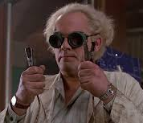
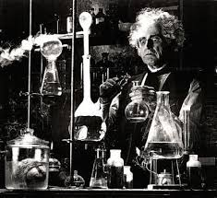
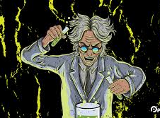
Mad Scientist

Slide 11
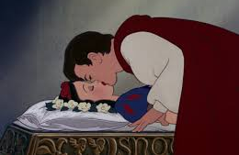
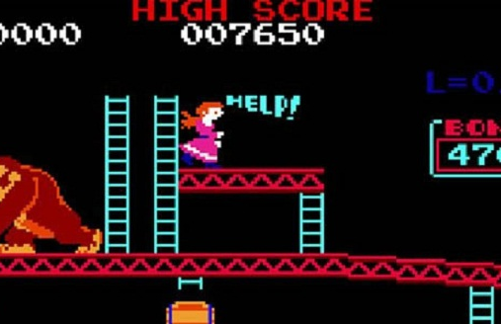
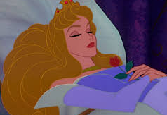
Damsel in Distress Archetype
Female character needs a hero (male) to rescue her and is ultimately defined by her passivity
Examples include: the princess figures in fairy tales (Sleeping Beauty and Snow White), Peach from Mario Bros. Universe, and Elizabeth from our novel

Slide 12
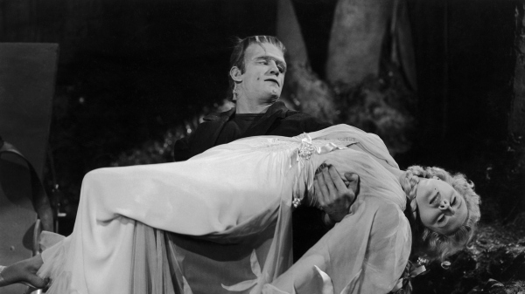

Slide 13
Narcissism
J. M. Hill argues in "Frankenstein and the Physiognomy of Desire" (1975) that Victor's "dominant incestuous root for Promethean sin seems to take hold in uncompromising psychic wishes for exclusive love, and in possession of the mother -- the source of first love."⁷ In articles appearing in the 1975 issue of Hartford Studies in Literature, Gerhard Joseph suggests that Victor's terror of incest is the veiled cause of his disintegration,⁸ while Gordon D. Hirsch concludes that the "monster is psychologically a lady, or perhaps one should say, a little girl."⁹ Mark A. Rubenstein (1976) discusses the primal scene imagery in Frankenstein, ingeniously showing how it "penetrates into the very structure of the novel and becomes part of a more deeply hidden search for the mother."¹⁰ Martin Trop's Mary Shelley's Monster (1976) and David Ketterer's Frankenstein's Creation: The Book, the Monster, and Human Reality (1979) offer additional psychological interpretations.¹¹ The Endurance of Frankenstein (1979) contains several excellent essays, including U. C. Knoepflmacher's "Thoughts on the Aggression of Daughters," which demonstrates that Frankenstein is a novel of emotionally distant fathers and absent mothers.¹² A psychiatrist argues in a 1982 essay that Mary Shelley conceived of herself as an "exception to the rules," an individual who sensed that she had suffered unjustly because of her mother's death.¹³ More recently, Mary Poovey fuses feminist and psychoanalytic criticism in The Proper Lady and the Woman Writer (1984),¹⁴ while William Veeder suggests in Mary Shelley & Frankenstein (1986) that the novel reflects the author's lifelong concern with the psychological ideal of androgyny and its opposite, bifurcation.¹⁵ The brief history of psychoanalytic criticism on Frankenstein thus reveals a movement from Oedipal to pre-Oedipal approaches.
Surprisingly, the narcissistic implications of the story have not yet been directly confronted.¹⁶ Mary Shelley subtitled Frankenstein the "Modern Prometheus," but she could have also referred to it as the "Modern Narcissus." Victor exhibits, in fact, all the characteristics of the narcissistic personality disorder as defined in DSM-III: a grandi- {59} ose sense of self-importance; preoccupation with fantasies of unlimited success; exhibitionism; cool indifference or feelings of rage in response to criticism; and interpersonal disturbances, including exploitativeness, alternation between overidealization and devaluation, and lack of empathy. Moreover, Victor demonstrates the paradoxical nature of narcissism, where self-love exists with self-hate, and fragile self-esteem results in a sense of entitlement, the expectation of receiving special favors from others without assuming reciprocal responsibilities. In addition, Victor pursues fantasies of unlimited power and glory with a pleasureless, monomaniacal intensity. He experiences the profound depression often accompanying a narcissistic disorder: dejection, loss of interest in the external world, inability to love, and a lowering of self-esteem, culminating in an expectation of punishment. It is as if he has internalized a poisonous object, the Creature, who is now consuming his heart.
Jeffrey Berman’s Narcissism and the Novel (New York: New York Univ. Press, 1990), pp. 56-77

Slide 14
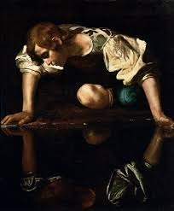
Narcissus

Slide 15
Critical Arguments on Frankenstein
1. Patrick Brantlinger’s “The Reading Monster” (468-476)
Frankenstein is, among other things, a novel about two educations or, rather, miseducations, Victor’s and the Monster’s…Victor…is a sort of autodidact—willfully so, because he chooses isolation. In contrast, the Monster is perforce an autodidact…Victor’s education is upper-class, indulgent, liberal… (469)
The Monster’s Bildungsroman both parallels and contrasts with Victor’s [consider the family DeLacey as compared to Victor’s]…
The story of Victor’s pursuit of arcane, in some sense forbidden knowledge involves his self-alienation—loss of self-knowledge, insanity, destruction. The story of the Monster’s acquisition of language and literacy is, in contrast, the narrative of his coming to self-knowledge…(471)

Slide 16
Brantlinger’s “The Reading Monster” Continued….
“What has seemed ultimately most monstrous and therefore most difficult for readers of Frankenstein over the years to accept is precisely the Monster’s literacy” (473).
As Brantlinger points out: why did so many theatrical and film adaptations of the novel erase the Monster’s literary acumen? Why did they take away his voice?
How would you support Brantlinger’s ideas? What passages from the novel suggest that the Monster’s education is the most “monstrous” part about him?

Slide 17
Mary Shelley’s and Frankenstein’s Legacy
What makes a novel a “classic”?
What are your criteria for a “classic novel”?
What other novels or films do you consider classics?

